Slide 1

Image classification (fashion apparel)
By: Lakshita Kain
Data Science Intern
Flip robo technologies

Slide 2

Introduction
Image classification (or Image recognition) is a subdomain of computer vision in which an algorithm looks at an image and assigns it a tag from a collection of predefined tags or categories that it has been trained on.
Vision is responsible for 80-85 percent of our perception of the world, and we, as human beings, trivially perform classification daily on whatever data we come across. Therefore, emulating a classification task with the help of neural networks is one of the first uses of computer vision.
Visual classification of commercial products is a branch of the wider fields of object detection and feature extraction in computer vision, and, in particular, it is an important step in the creative workflow in fashion industries. Automatically classifying garment features makes both designers and data experts aware of their overall production, which is fundamental in order to organize marketing campaigns, avoid duplicates, categorize apparel products for e-commerce purposes, and so on. There are many different techniques for visual classification, ranging from standard image processing to machine learning approaches
Our study describes a real-world study aimed at automatically recognizing and classifying 3 different objects of clothing such as Saree (Women), Jeans (Men) and Trousers (Men), solely from ﬁnal rendering images of their products.

Slide 3

Problem Statement
Object detection is one of the important technologies in the field of computer vision. In the area of fashion apparel, object detection technology has various applications, such as apparel recognition, apparel detection, fashion recommendation, and online search. The recognition task is difficult for a computer because fashion apparel images have different characteristics of clothing appearance and material. In fashion industries, obtaining a visual analysis of the overall production is a key aspect, both in developing marketing strategies and for helping fashion designers in the creative workﬂow of new products. Transfer learning is the process of applying knowledge and skills learned in previous tasks to target tasks.
Our dataset consists of 3 labels of Apparels such as Saree (Women), Jeans (Men) and Trousers (Men). This project aims to implement Deep Learning algorithms transfer learning using VGG-16, VGG-19 and Inception v3 using keras. Data used in this project are online products collected from “amazon.com”.

Slide 4
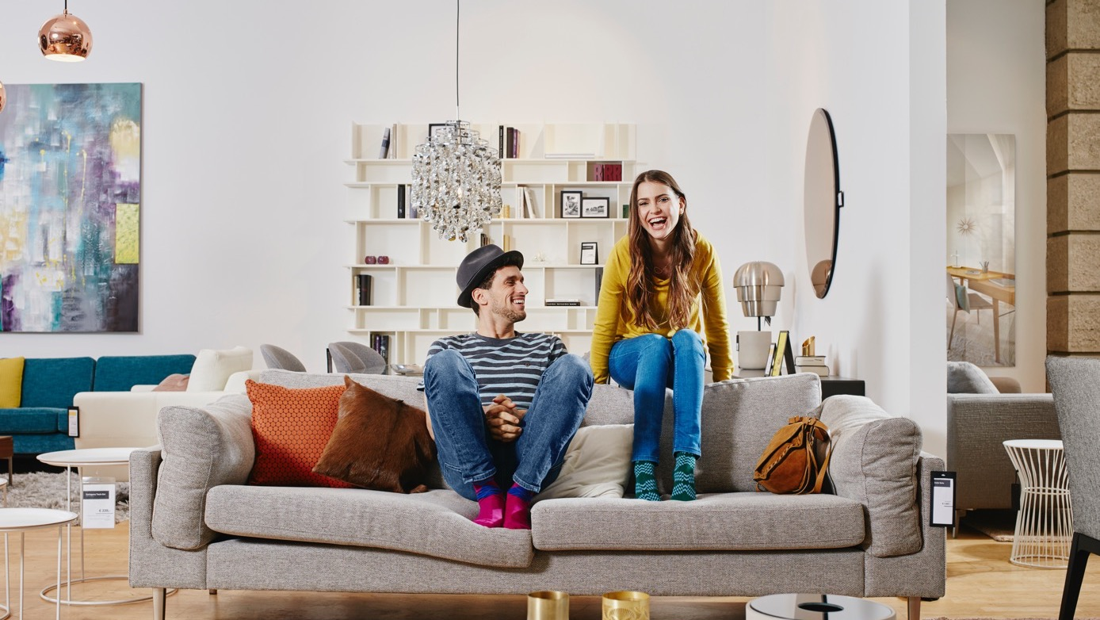
Slide title 29
DATA COLLECTION
Data has been scrapped using Selenium webdriver with python. Selenium is a powerful tool for controlling web browsers through programs and performing browser automation.
Our data has been retrieved from https://www.amazon.com which consists of Fashion Apparel Images such as Men’s Jeans, Trousers and Women’s Saree.
Our Dataset consists of Our dataset consists Images of the product. 900 images were retrieved of each of the three categories to create a balanced dataset and overcome overfitting/underfitting of any particular label.

Slide 5

Data Preprocessing using ImageNet
ImageNet is formally a project aimed at (manually) labeling and categorizing images into almost 22,000 separate object categories for the purpose of computer vision research. However, when we hear the term “ImageNet” in the context of deep learning and Convolutional Neural Networks, we are likely referring to the ImageNet Large Scale Visual Recognition Challenge, or ILSVRC for short.
The goal of this image classification challenge is to train a model that can correctly classify an input image into 3 separate object categories. Models are trained on 712 training images with another 172 images for validation.
When it comes to image classification, the ImageNet challenge is the de facto benchmark for computer vision classification algorithms — and the leaderboard for this challenge has been dominated by Convolutional Neural Networks and deep learning techniques since 2012.
The state-of-the-art pre-trained networks included in the Keras core library represent some of the highest performing Convolutional Neural Networks on the ImageNet challenge over the past few years. These networks also demonstrate a strong ability to generalize to images outside the ImageNet dataset via transfer learning, such as feature extraction and fine-tuning.

Slide 6
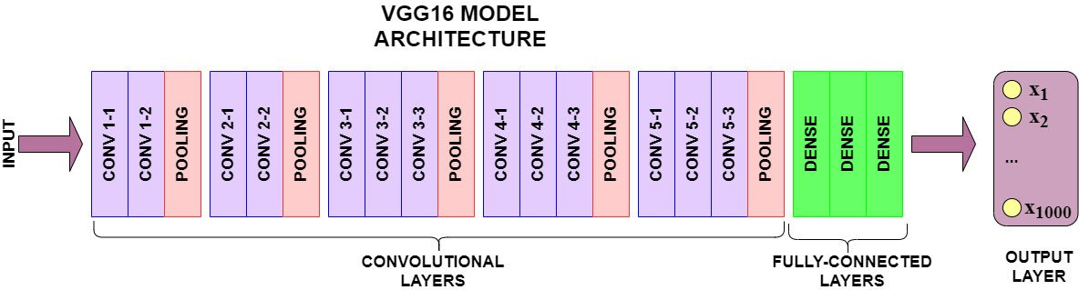
Vgg 16 architecture
VGG-16 model architecture – 13 convolutional layers and 2 Fully connected layers and 1 SoftMax classifier VGG-16 - Karen Simonyan and Andrew Zisserman introduced VGG-16 architecture in 2014 in their paper Very Deep Convolutional Network for Large Scale Image Recognition. Karen and Andrew created a 16-layer network comprised of convolutional and fully connected layers. Using only 3×3 convolutional layers stacked on top of each other for simplicity.

Slide 7
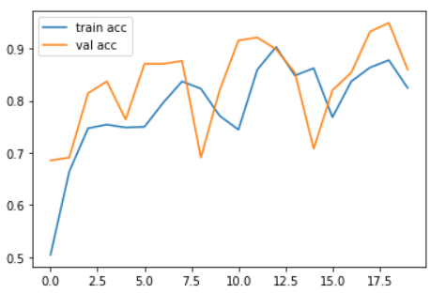
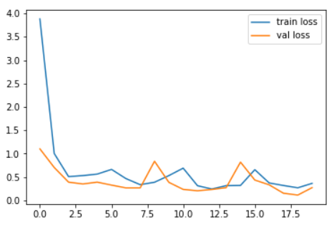
Vgg 16 Accuracy and loss

Slide 8
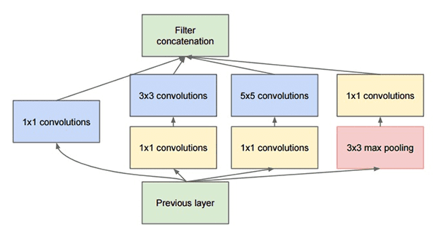
Inception V3 using Keras
The “Inception” micro-architecture was first introduced by Szegedy et al. in their 2014 paper, Going Deeper with Convolutions.
The goal of the inception module is to act as a “multi-level feature extractor” by computing 1×1, 3×3, and 5×5 convolutions within the same module of the network — the output of these filters are then stacked along the channel dimension and before being fed into the next layer in the network.
The original incarnation of this architecture was called GoogLeNet, but subsequent manifestations have simply been called Inception vN where N refers to the version number put out by Google.
The Inception V3 architecture included in the Keras core comes from the later publication by Szegedy et al., Rethinking the Inception Architecture for Computer Vision (2015) which proposes updates to the inception module to further boost ImageNet classification accuracy.
The weights for Inception V3 are smaller than both VGG and ResNet, coming in at 96MB.

Slide 9
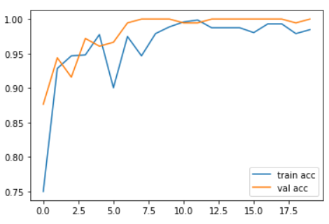
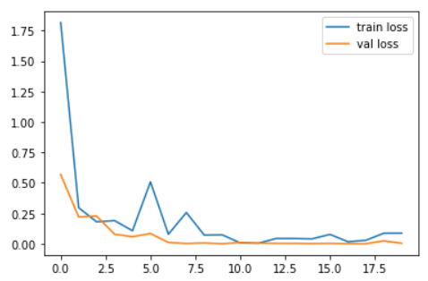
Inception v3 Accuracy and loss

Slide 10
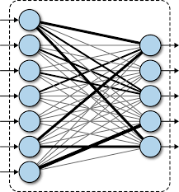
Conclusion
This research evaluated the image classification of fashion apparel using deep learning models. Using real time data, we compared two CNN models VGG16 and InceptionNet V3 using transfer learning with Keras by performing detailed experimental analysis while classifying the Image detected into 3 categories.
It was further concluded that our Inception v3 using keras model outperformed vgg16.

Slide 11
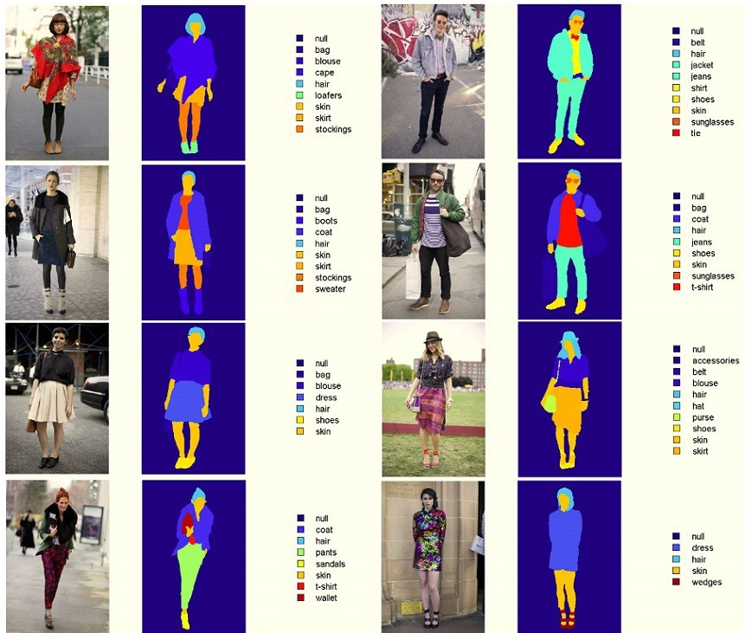
Thank you!

